Slide 1
Teletown Hall
May 26, 2021
New CMS Health Information Exchange
Bi-Directional Exchange Measure
Notes:
Good afternoon and welcome to the NC HealthConnex Teletown Hall. Today we will be talking about Value Added Services.

Slide 2
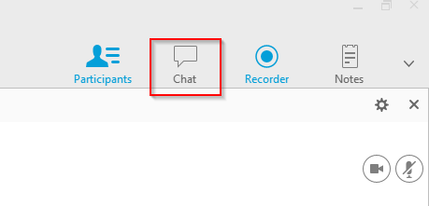
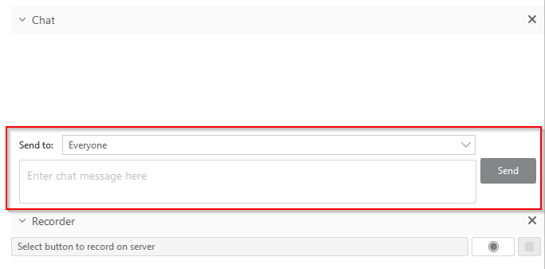
Before We Begin…
Housekeeping Items with WebEx
Notes:
Before we begin, I’d like to run through a few housekeeping items:
Due to the limited amount of time allotted for this presentation, we will be putting everyone on mute. If you have questions, please utilize the Chat feature within the WebEx.
- Click on the chat icon shown in the red square, then type your question in the text box as shown in the red rectangle.
- We will try to address questions at the end of the presentation. If you have questions specifically related to your practice, we will contact you individually to answer those. Otherwise, feel free to reach out to us directly. We will provide you with our contact information at the close of today’s presentation.

Slide 3
Introductions
North Carolina Health Information Exchange Authority (NC HIEA)
Jessica Brehmer - Business Development and Outreach Specialist
Kenya Servia - Business Development and Outreach Specialist
Terri Roberts – Special Guest (NC AHEC)
NC HealthConnex SAS Help Desk Team
Holli Elliott - Technical Support Analyst
Notes:
My name is Holli Elliott and I am with the NC HeatlhConnex Help Desk Team
Our presenters today will be Jessica Brehmer and Kenya Servia – Business and Outreach Specialist and Tim Taylor – Application Systems Specialist – All with the North Carolina Health Information Exchange Authority.
And now I will turn this presentation over to Jessica Brehmer will talking to you about clinical portal usage.

Slide 4
Partnership
Notes:
Before we begin, I’d like to run through a few housekeeping items:
Due to the limited amount of time allotted for this presentation, we will be putting everyone on mute. If you have questions, please utilize the Chat feature within the WebEx.
- Click on the chat icon shown in the red square, then type your question in the text box as shown in the red rectangle.
- We will try to address questions at the end of the presentation. If you have questions specifically related to your practice, we will contact you individually to answer those. Otherwise, feel free to reach out to us directly. We will provide you with our contact information at the close of today’s presentation.

Slide 5
New CMS Health Information Exchange Bi-Directional Exchange Measure
Terri Roberts, MS, PCMH CCE
Notes:
Before we begin, I’d like to run through a few housekeeping items:
Due to the limited amount of time allotted for this presentation, we will be putting everyone on mute. If you have questions, please utilize the Chat feature within the WebEx.
- Click on the chat icon shown in the red square, then type your question in the text box as shown in the red rectangle.
- We will try to address questions at the end of the presentation. If you have questions specifically related to your practice, we will contact you individually to answer those. Otherwise, feel free to reach out to us directly. We will provide you with our contact information at the close of today’s presentation.

Slide 6
NC HealthConnex by the Numbers
We connect health care providers to safely and securely share health information through a trusted network to improve health care quality and outcomes for North Carolinians.
NC HealthConnex, By the Numbers:
Over 60,000 providers with contributed records
6,700+ health care facilities live submitting data, including 125 hospitals
5,000+ health care facilities in onboarding
120 million+ continuity of care documents (CCDs)
14M+ unique patient records
8 Electronic Health Record (EHR) vendors with bi-directional interface
22+ border and interstate HIEs connected via the eHealth Exchange and the Patient Centered Data Home, including connections to the VA and DoD
STATE DESIGNATED
SECURE
PARTNERSHIP
Notes:
State Agency, State and federal funding (we’ll talk more about federal funding shortly)
Public-private partnership with SAS Institute
Currently have 16 teams members comprised of a provider relations/outreach team, a team of analysts, and leadership. Will be hiring an additional five employees in the next 3-6 months. There is a group of about 12 SAS dedicated resources as well that includes the Help Desk, technical analysts and PMs. Excited to be adding AHEC coaches to this statewide effort.
Agency Partnerships – DHHS - Medicaid, Office of Rural Health, Division of Public Health, Health Services Regulation, Division of Mental Health, Office of the Treasurer: State Health Plan, Department of Public Safety (prisons are future integration)

Slide 7
Road Map
2019 QPP Performance – Background for Why?
2021 Topic Overview
PI Health Information Exchange (HIE)
Bi-Directional Exchange
Notes:
Before we begin, I’d like to run through a few housekeeping items:
Due to the limited amount of time allotted for this presentation, we will be putting everyone on mute. If you have questions, please utilize the Chat feature within the WebEx.
- Click on the chat icon shown in the red square, then type your question in the text box as shown in the red rectangle.
- We will try to address questions at the end of the presentation. If you have questions specifically related to your practice, we will contact you individually to answer those. Otherwise, feel free to reach out to us directly. We will provide you with our contact information at the close of today’s presentation.

Slide 8
2019 QPP Performance
Background for Why?
Notes:
Before we begin, I’d like to run through a few housekeeping items:
Due to the limited amount of time allotted for this presentation, we will be putting everyone on mute. If you have questions, please utilize the Chat feature within the WebEx.
- Click on the chat icon shown in the red square, then type your question in the text box as shown in the red rectangle.
- We will try to address questions at the end of the presentation. If you have questions specifically related to your practice, we will contact you individually to answer those. Otherwise, feel free to reach out to us directly. We will provide you with our contact information at the close of today’s presentation.

Slide 9
2019 Performance Data
Source: 2019 QPP Performance Data Infographic: https://qpp-cm-prod-content.s3.amazonaws.com/uploads/1190/QPP%202019%20Participation%20Results%20Infographic.pdf
Notes:
Before we begin, I’d like to run through a few housekeeping items:
Due to the limited amount of time allotted for this presentation, we will be putting everyone on mute. If you have questions, please utilize the Chat feature within the WebEx.
- Click on the chat icon shown in the red square, then type your question in the text box as shown in the red rectangle.
- We will try to address questions at the end of the presentation. If you have questions specifically related to your practice, we will contact you individually to answer those. Otherwise, feel free to reach out to us directly. We will provide you with our contact information at the close of today’s presentation.

Slide 10
2020 Performance Year/2022 Payment Year - Final
Final Score Points | MIPS Adjustment
>/= 85 points | >0% + minimum of additional 0.5% (exceptional performance threshold)
45.01-84.99 points | >0%
45 points | 0% payment adjustment
11.26-44.99 | -7% to <0%
0-11.25 points | -7%
2021 Performance Year/2023 Payment Year - Final
MIPS Adjustment | Final Score Points
>0% + minimum of additional 0.5% (exceptional performance threshold) | >/= 85 points
>0% | 60.01-84.99 points
0% payment adjustment | 60 points
-9% to <0% | 15.01-59.99
-9% | 0-15 points
Notes:
Before we begin, I’d like to run through a few housekeeping items:
Due to the limited amount of time allotted for this presentation, we will be putting everyone on mute. If you have questions, please utilize the Chat feature within the WebEx.
- Click on the chat icon shown in the red square, then type your question in the text box as shown in the red rectangle.
- We will try to address questions at the end of the presentation. If you have questions specifically related to your practice, we will contact you individually to answer those. Otherwise, feel free to reach out to us directly. We will provide you with our contact information at the close of today’s presentation.

Slide 11
Payment Adjustments
Payment Year | Max Payment Adjustment
2021 (2019 Performance Year) | 1.79%
2020 (2018 Performance Year) | 1.68%
2019 (2017 Performance Year) | 1.88%
Source: 2019 QPP Performance Data Infographic: https://qpp-cm-prod-content.s3.amazonaws.com/uploads/1190/QPP%202019%20Participation%20Results%20Infographic.pdf
Notes:
Before we begin, I’d like to run through a few housekeeping items:
Due to the limited amount of time allotted for this presentation, we will be putting everyone on mute. If you have questions, please utilize the Chat feature within the WebEx.
- Click on the chat icon shown in the red square, then type your question in the text box as shown in the red rectangle.
- We will try to address questions at the end of the presentation. If you have questions specifically related to your practice, we will contact you individually to answer those. Otherwise, feel free to reach out to us directly. We will provide you with our contact information at the close of today’s presentation.

Slide 12
What Happens in 2021?
Notes:
Before we begin, I’d like to run through a few housekeeping items:
Due to the limited amount of time allotted for this presentation, we will be putting everyone on mute. If you have questions, please utilize the Chat feature within the WebEx.
- Click on the chat icon shown in the red square, then type your question in the text box as shown in the red rectangle.
- We will try to address questions at the end of the presentation. If you have questions specifically related to your practice, we will contact you individually to answer those. Otherwise, feel free to reach out to us directly. We will provide you with our contact information at the close of today’s presentation.

Slide 13
MIPS Updates in 2021
May use certified technology meeting the existing 2015 Edition certification criteria, updated to the 2015 Edition Cures Update, or a combination of the two
+/- 9% max payment adjustment
Health Information Exchange (HIE)
Send/Receive or Bi-Directional Interface with NC HealthConnex
Notes:
Before we begin, I’d like to run through a few housekeeping items:
Due to the limited amount of time allotted for this presentation, we will be putting everyone on mute. If you have questions, please utilize the Chat feature within the WebEx.
- Click on the chat icon shown in the red square, then type your question in the text box as shown in the red rectangle.
- We will try to address questions at the end of the presentation. If you have questions specifically related to your practice, we will contact you individually to answer those. Otherwise, feel free to reach out to us directly. We will provide you with our contact information at the close of today’s presentation.

Slide 14
Performance Category Weights
Category | 2021 Traditional | 2021 MIPS APM
Quality | 40% | 50%
Cost | 20% | 0%
Promoting Interoperability | 20% | 30%
Improvement Activities | 30% | 20%
Notes:
Before we begin, I’d like to run through a few housekeeping items:
Due to the limited amount of time allotted for this presentation, we will be putting everyone on mute. If you have questions, please utilize the Chat feature within the WebEx.
- Click on the chat icon shown in the red square, then type your question in the text box as shown in the red rectangle.
- We will try to address questions at the end of the presentation. If you have questions specifically related to your practice, we will contact you individually to answer those. Otherwise, feel free to reach out to us directly. We will provide you with our contact information at the close of today’s presentation.

Slide 15
2021 Promoting Interoperability
Notes:
Before we begin, I’d like to run through a few housekeeping items:
Due to the limited amount of time allotted for this presentation, we will be putting everyone on mute. If you have questions, please utilize the Chat feature within the WebEx.
- Click on the chat icon shown in the red square, then type your question in the text box as shown in the red rectangle.
- We will try to address questions at the end of the presentation. If you have questions specifically related to your practice, we will contact you individually to answer those. Otherwise, feel free to reach out to us directly. We will provide you with our contact information at the close of today’s presentation.

Slide 16
Promoting Interoperability (PI)
Weight: 30% for MIPS APM and 20% of Traditional MIPS
Reporting period: continuous 90 days minimum
Patient population reporting requirement: all patients
Points: 10-40 points per measure
Promoting Interoperability: Total maximum points of 100
Bi-Directional Interface: worth 40 of the 100 total points – single greatest point measure
Source: CMS Final Rule, November 2019
Notes:
Before we begin, I’d like to run through a few housekeeping items:
Due to the limited amount of time allotted for this presentation, we will be putting everyone on mute. If you have questions, please utilize the Chat feature within the WebEx.
- Click on the chat icon shown in the red square, then type your question in the text box as shown in the red rectangle.
- We will try to address questions at the end of the presentation. If you have questions specifically related to your practice, we will contact you individually to answer those. Otherwise, feel free to reach out to us directly. We will provide you with our contact information at the close of today’s presentation.

Slide 17
Promoting Interoperability (PI)
Objective | Measure | Maximum Points
e-Prescribing | e-Prescribing | 10 points
 | Bonus: Query of Prescription Drug Monitoring Program (PDMP) | Bonus: 10 Points (5 points in 2020)
Health Information Exchange | Support Electronic Referral Loops by Sending Health Information | 20 points
 | Support Electronic Referral Loops by Receiving and Incorporating Health Information | 20 points
 | OR
 | Health Information Exchange (HIE) Bi-Directional Exchange | 40 Points
Provider to Patient Exchange | Provide Patients Electronic Access to Their Health Information | 40 points
Public Health and Clinical Data Exchange (Attest YES to 2; or YES to 1 and Exclude 1) | Report to two different public health agencies or clinical data registries for any of the following: Immunization Registry Reporting (must be bi-directional) Electronic Case Reporting (not available for practices) Public Health Registry Reporting (NC HealthConnex Diabetes Registry) Enrollment Form Clinical Data Registry Reporting Syndromic Surveillance Reporting (not available for practices) | 10 points
Source: CMS Final Rule, November 2019
Notes:
Before we begin, I’d like to run through a few housekeeping items:
Due to the limited amount of time allotted for this presentation, we will be putting everyone on mute. If you have questions, please utilize the Chat feature within the WebEx.
- Click on the chat icon shown in the red square, then type your question in the text box as shown in the red rectangle.
- We will try to address questions at the end of the presentation. If you have questions specifically related to your practice, we will contact you individually to answer those. Otherwise, feel free to reach out to us directly. We will provide you with our contact information at the close of today’s presentation.

Slide 18
Objective: Health Information Exchange
Measures: Send/Receive
Support Electronic Referral Loops by Sending Health Information
1-20 points based on performance
Must include current problem list, current medication list, and current medication allergies or a notation of no current problem, medication, and/or medication allergy
Support Electronic Referral Loops by Receiving and Reconciling Health Information
1-20 points based on performance
Denominator: Number of electronic summary of care records received for a transition of care or referral and for patient encounters in which the clinician has never encountered the patient before.
Must complete reconciliation for Medications, Medication Allergies, and Current Problem List
Notes:
Before we begin, I’d like to run through a few housekeeping items:
Due to the limited amount of time allotted for this presentation, we will be putting everyone on mute. If you have questions, please utilize the Chat feature within the WebEx.
- Click on the chat icon shown in the red square, then type your question in the text box as shown in the red rectangle.
- We will try to address questions at the end of the presentation. If you have questions specifically related to your practice, we will contact you individually to answer those. Otherwise, feel free to reach out to us directly. We will provide you with our contact information at the close of today’s presentation.

Slide 19
ALTERNATIVE: QPP 2021 New Measure Specification Sheet for Bi-Directional Exchange
Notes:
Before we begin, I’d like to run through a few housekeeping items:
Due to the limited amount of time allotted for this presentation, we will be putting everyone on mute. If you have questions, please utilize the Chat feature within the WebEx.
- Click on the chat icon shown in the red square, then type your question in the text box as shown in the red rectangle.
- We will try to address questions at the end of the presentation. If you have questions specifically related to your practice, we will contact you individually to answer those. Otherwise, feel free to reach out to us directly. We will provide you with our contact information at the close of today’s presentation.

Slide 20
Reporting Requirements
YES/NO
The MIPS eligible clinician must attest YES or TRUE to the following:
I participate in an HIE in order to enable secure, bi-directional exchange to occur for every patient encounter, transition or referral, and record stored or maintained in the EHR during the performance period in accordance with applicable law and policy.
The HIE that I participate in is capable of exchanging information across a broad network of unaffiliated exchange partners including those using disparate EHRs, and does not engage in exclusionary behavior when determining exchange partners.
I use the functions of CEHRT to support bi-directional exchange with an HIE.
Notes:
Before we begin, I’d like to run through a few housekeeping items:
Due to the limited amount of time allotted for this presentation, we will be putting everyone on mute. If you have questions, please utilize the Chat feature within the WebEx.
- Click on the chat icon shown in the red square, then type your question in the text box as shown in the red rectangle.
- We will try to address questions at the end of the presentation. If you have questions specifically related to your practice, we will contact you individually to answer those. Otherwise, feel free to reach out to us directly. We will provide you with our contact information at the close of today’s presentation.

Slide 21
Scoring Information
Required for Promoting Interoperability Performance Category Score: Yes, if submitting as al alternative to the Support Electronic Referral Loops by Sending Health Information and the Support Electronic Referral Loops by Receiving and Reconciling measures (HIE_1 and HIE_4)
Measure Score: 40 points
Eligible for Bonus Score: No
Notes:
Before we begin, I’d like to run through a few housekeeping items:
Due to the limited amount of time allotted for this presentation, we will be putting everyone on mute. If you have questions, please utilize the Chat feature within the WebEx.
- Click on the chat icon shown in the red square, then type your question in the text box as shown in the red rectangle.
- We will try to address questions at the end of the presentation. If you have questions specifically related to your practice, we will contact you individually to answer those. Otherwise, feel free to reach out to us directly. We will provide you with our contact information at the close of today’s presentation.

Slide 22
2021 QPP MIPS PI Data Validation Criteria During the 90-day Reporting Period
The MIPS eligible clinician or group must establish the technical capacity and workflows to engage in bi-directional exchange via an HIE for all patients seen by the eligible clinician and for any patient record stored or maintained in their EHR, consistent with their attestation statements.
Notes:
Before we begin, I’d like to run through a few housekeeping items:
Due to the limited amount of time allotted for this presentation, we will be putting everyone on mute. If you have questions, please utilize the Chat feature within the WebEx.
- Click on the chat icon shown in the red square, then type your question in the text box as shown in the red rectangle.
- We will try to address questions at the end of the presentation. If you have questions specifically related to your practice, we will contact you individually to answer those. Otherwise, feel free to reach out to us directly. We will provide you with our contact information at the close of today’s presentation.

Slide 23
2021 MIPS PI Data Validation Criteria During the 90 Day reporting period – Documentation Requirements
A dated report or screenshot that documents successful receipt and transmission of patient data via the entity providing health information exchange services. Should include evidence to support that it was generated for that MIPS eligible clinician’s system (e.g., identified by National Provider Identifier (NPI), clinician name, practice name, etc.). AND/OR
Letter, email or other documentation from the entity providing health information exchange services confirming participation of MIPS eligible clinician, the date of on-boarding, a description of services provided, and a description of exchange network participants (e.g. number/type of participating providers). OR
Letter, email or other documentation from the MIPS eligible clinician’s CEHRT vendor confirming a connection between the eligible clinician’s CEHRT and an entity providing health information exchange services, the date of on-boarding, a description of services provided, and a description of exchange network participants (e.g. number/type of participating providers) for the duration of the performance period.
Notes:
Before we begin, I’d like to run through a few housekeeping items:
Due to the limited amount of time allotted for this presentation, we will be putting everyone on mute. If you have questions, please utilize the Chat feature within the WebEx.
- Click on the chat icon shown in the red square, then type your question in the text box as shown in the red rectangle.
- We will try to address questions at the end of the presentation. If you have questions specifically related to your practice, we will contact you individually to answer those. Otherwise, feel free to reach out to us directly. We will provide you with our contact information at the close of today’s presentation.

Slide 24
So What is a Bi-Directional Interface with the NC HIEA/NC Healthconnex?
Notes:
Before we begin, I’d like to run through a few housekeeping items:
Due to the limited amount of time allotted for this presentation, we will be putting everyone on mute. If you have questions, please utilize the Chat feature within the WebEx.
- Click on the chat icon shown in the red square, then type your question in the text box as shown in the red rectangle.
- We will try to address questions at the end of the presentation. If you have questions specifically related to your practice, we will contact you individually to answer those. Otherwise, feel free to reach out to us directly. We will provide you with our contact information at the close of today’s presentation.

Slide 25
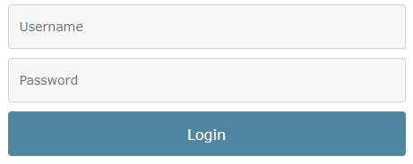
Exchange
Web-based Portal
Uni-directional Connection
Electronic Health Record Clinicians enter data into EHR and that data is pulled into HIE
Data Provided
Clinicians who have care relationships with their patients are able readily access that data
Electronic Health Record Clinicians enter data into EHR and that data is automatically sent to HIE
Data Provided
Clinicians who have care relationships with their patients are readily able to access that data
Login using any browser
Notes:
The uni-directional connection is the same as with the bi-directional connection in how healthcare organizations send data to NC HealthConnex. With a uni-direction connection, the provider or Health care staff member will enter the patient’s information into the electronic health record when the patient encounter occurs. After the encounter is closed, the information will automatically be sent to NC healthconnex . Once we receive the information, we store the information in our central repository. Because data does not flow back to your EHR, you can log into our clinical portal using any web browser to access patient’s longitudinal health record.

Slide 26
Exchange
Electronic Health Record Integration
Bi-directional Connection
Data Provided
Clinicians who have care relationships with their patients are able readily access that data
Electronic Health Record Clinicians enter data into EHR and that data is automatically sent to the HIE
Data Sent into EHR
Clinicians who have care relationships with their patients are able readily access that data via their EHR
26
Notes:
I want to first explain how healthcare organizations can send data but also receive data back about their patients. You must be a full participant in order to access clinical information from NC HealthConnex. With a bi-directional connection, the provider or Health care staff member will enter the patient’s information into the electronic health record when the patient encounter occurs. After the encounter is closed, the information will automatically be sent to NC healthconnex . Once we receive the information, we store the information in our central repository. If your EHR vendor has the capability for us to sit inside of their platform , information can flow back into your EHR.

Slide 27
Bi-Directional Interface
WHY?
Quicker access within the clinical workflow to patient information from external providers
Required for integration with NCIR
Potential for CVMS data integration
Next step in information sharing
Replaces Send/Receive Measure Performance Requirement
NC HealthConnex Participants - Who’s Connected
Notes:
Before we begin, I’d like to run through a few housekeeping items:
Due to the limited amount of time allotted for this presentation, we will be putting everyone on mute. If you have questions, please utilize the Chat feature within the WebEx.
- Click on the chat icon shown in the red square, then type your question in the text box as shown in the red rectangle.
- We will try to address questions at the end of the presentation. If you have questions specifically related to your practice, we will contact you individually to answer those. Otherwise, feel free to reach out to us directly. We will provide you with our contact information at the close of today’s presentation.

Slide 28
Bi-Directional Interface Return On Investment (ROI)
Benefits
Assists to achieve maximum Medicare revenue with positive adjustments
Potential Direct integration with NCIR to EHR (as available)
Reduces data entry time and efforts
Reduce vaccination gaps in EHR
Increase potential vaccinations given
Reduce staff time by eliminating duplicative work (DSM/NCIR)
Replaces Send/Receive Measure Performance Requirement
Notes:
Before we begin, I’d like to run through a few housekeeping items:
Due to the limited amount of time allotted for this presentation, we will be putting everyone on mute. If you have questions, please utilize the Chat feature within the WebEx.
- Click on the chat icon shown in the red square, then type your question in the text box as shown in the red rectangle.
- We will try to address questions at the end of the presentation. If you have questions specifically related to your practice, we will contact you individually to answer those. Otherwise, feel free to reach out to us directly. We will provide you with our contact information at the close of today’s presentation.

Slide 29
Bi-Directional Interface
HOW?
Check with EHR
Capability Built with NC HealthConnex Currently:
Athena
Cerner
eClinicalWorks
Epic
HIS-Netsmart
Meditech
NextGen
Thrive by Evident
Other EHRs may have the capability upon customer request
Cost (implementation and/or monthly fee)
Process (Contact the NC HIEA team at HIEA@nc.gov)
Notes:
Before we begin, I’d like to run through a few housekeeping items:
Due to the limited amount of time allotted for this presentation, we will be putting everyone on mute. If you have questions, please utilize the Chat feature within the WebEx.
- Click on the chat icon shown in the red square, then type your question in the text box as shown in the red rectangle.
- We will try to address questions at the end of the presentation. If you have questions specifically related to your practice, we will contact you individually to answer those. Otherwise, feel free to reach out to us directly. We will provide you with our contact information at the close of today’s presentation.

Slide 30
Neighboring Connections via eHealth Exchange
Query Neighboring States/National Repositories via Connections via eHealth Exchange
Coastal Connect (CCHIE)
ETHIN (East Tennessee)
GaHIN (Georgia’s state-designated HIE)
MedVirginia (Richmond, Va.)
SCHIEX (South Carolina)
VA HIE (Veterans Administration) and DMIX (Dept. of Defense)
Notes:
Who is Connected?
Connectivity spans all 50 states, representing:
• 4 federal agencies
• 75% of US hospitals
• 70,000 medical groups
• 3,400 dialysis centers
• 8,300 pharmacies
• 120 million patients
• 47 state & regional HIEs

Slide 31
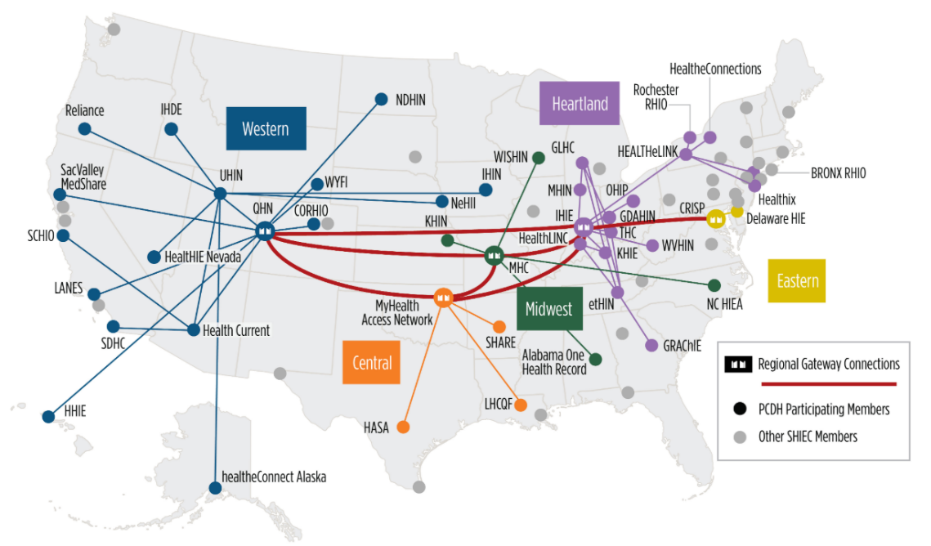
Exchange
Expanding Exchange Reach & Capabilities
NC HealthConnex has loaded all 45 participating HIEs zip codes into our system to capture out-of-state visits to North Carolina. Current HIEs sending patient alerts to NC HealthConnex include:
Arizona – Health Current
Alabama – Alabama One Health Record
California – Santa Cruz Health Information Organization
Colorado – Colorado Regional Health Information Organization (CORHIO)
Colorado – Quality Health Network
Eastern Tennessee – Eastern Tennessee Health Information Network (ETHIN)
Idaho – Idaho Health Data Exchange
Indiana – Indiana Health Information Exchange (IHIE)
Louisiana – Louisiana Health Care Quality Forum
Maryland – Chesapeake Regional Information System for our Patients (CRISP)
Michigan/Indiana – Michiana Health Information Exchange (MHIN)
Missouri – Midwest Health Connection
Ohio – The Health Collaborative
Oklahoma – MyHealth Access Network
Oregon – Reliance eHealth Collaborative
Texas – Healthcare Access San Antonio (HASA)
West Virginia – West Virginia Health Information Network (WVHIN)
Patient Centered Data Home (PCDH)
31
Company Confidential – For Internal Use Only
Copyright © SAS Institute Inc. All rights reserved.

Slide 32
NC HealthConnex Bi-directional: User Testimonials
The ability to exchange health care data across different organizations is vital to patient care. UNC Health Care has been submitting data to NC HealthConnex for many years and it is our hope that other health facilities have made good use of that data to provide the best possible care. UNC Health Care benefits as other organizations submit patient data to NC HealthConnex. We see tremendous benefit to provide our care givers, at the point of care, valuable clinical data when the providers need it – the right information to the right people at the right time.
-UNC Health Care

Slide 33
Exchange
Resources
Check Participation Status
QPP Resource Library
2018 QPP Performance Data Infographic
2019 QPP Performance Data Infographic
2021 Promoting Interoperability Measure Specifications
MAHEC Practice Support
Company Confidential – For Internal Use Only
Copyright © SAS Institute Inc. All rights reserved.

Slide 34
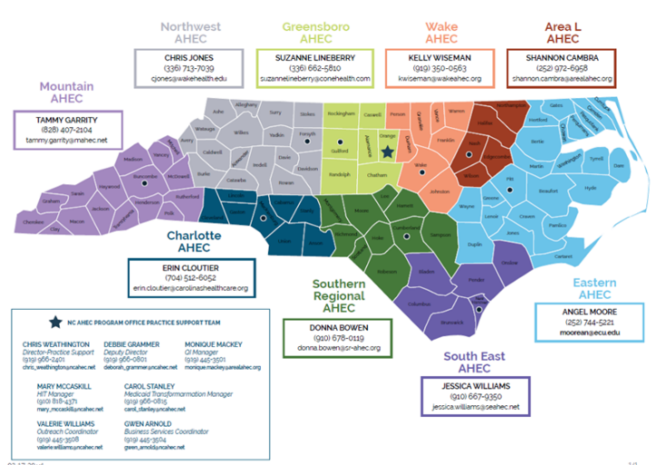
Exchange
How to Reach NC AHEC Practice Support
Company Confidential – For Internal Use Only
Copyright © SAS Institute Inc. All rights reserved.

Slide 35
Thank You!
Interested in connecting? Questions or feedback?
919-754-6912
www.nchealthconnex.gov
hiea@nc.gov
Technical Issues:
SAS NC HealthConnex Help Desk
HIESupport@sas.com
Phone: 919-531-2700 or Toll Free: 800-727-0025

